Slide 1
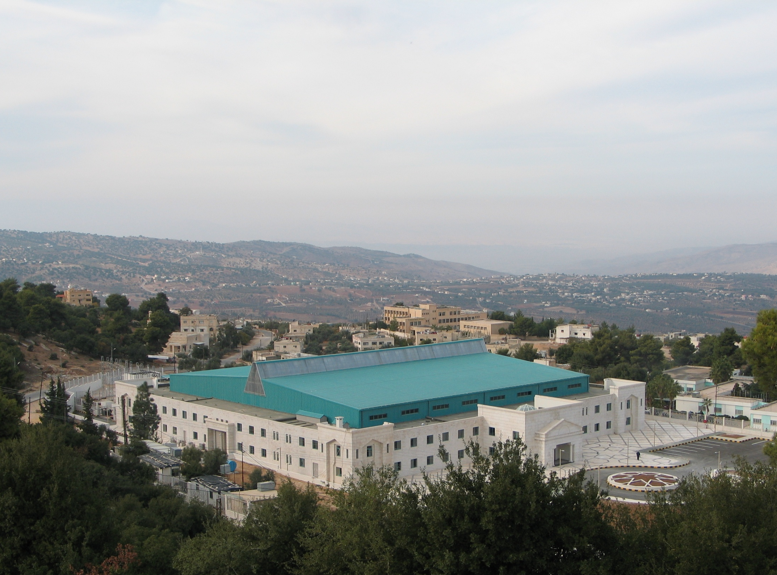
SESAME
SESAME RF SYSTEM
Arash Kaftoosian

Slide 2
SESAME = Synchrotron light for Experimental Science and Applications in the Middle East
is a 2.5 GeV synchrotron radiation facility, under construction near Amman, Jordan.
The members are Bahrain, Cyprus, Egypt, Iran, Israel, Jordan, Pakistan, Palestinian Authority and Turkey
Observers: France, Germany, Greece, Italy, Japan, Kuwait, Morocco, Portugal, Russia, Sweden, UK, USA

Slide 3
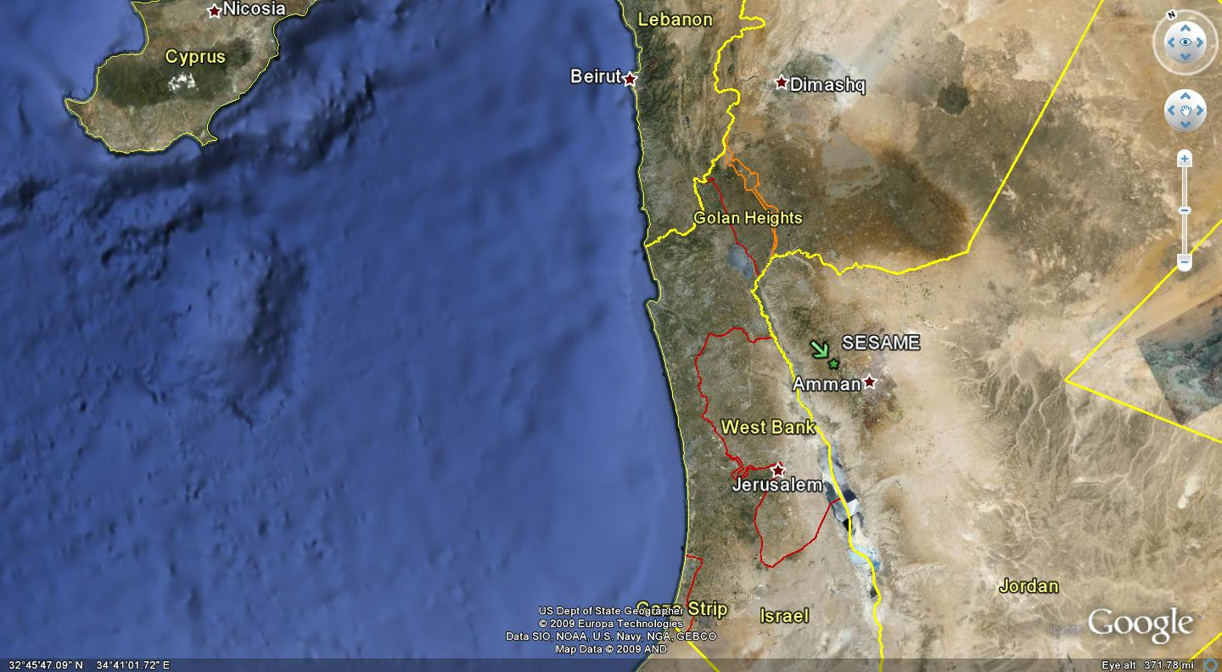
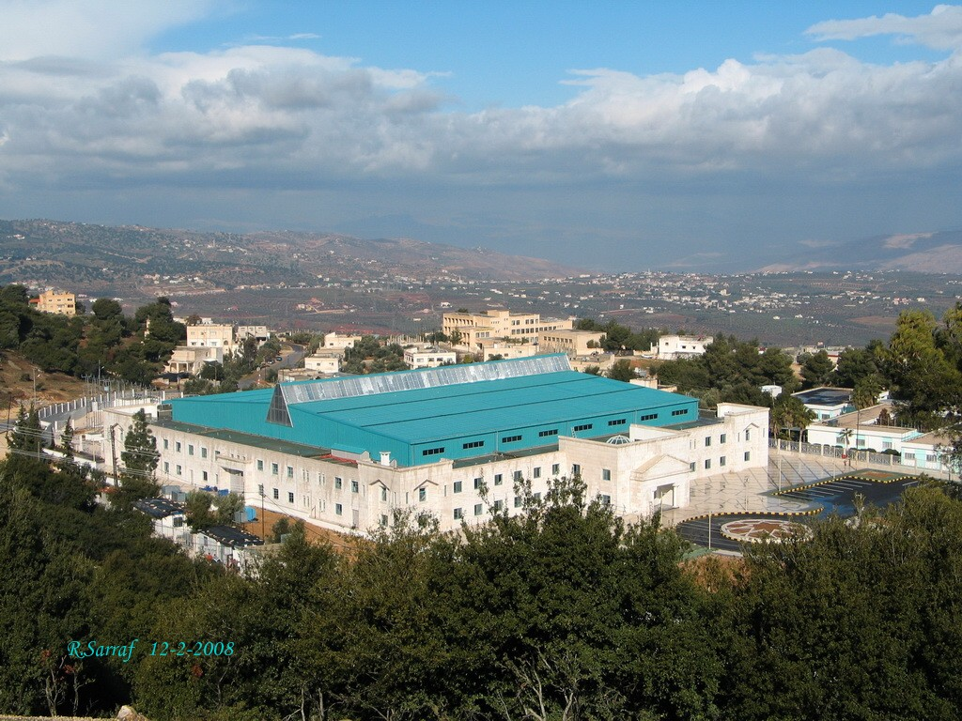
SESAME Location and the Member states
Cyprus
Members:
Bahrain
Cyprus
Egypt
Iran
Israel
Jordan
Pakistan
Palestine
Turkey
Lebanon
Syria
Palestine
Jordan
Israel

Slide 4
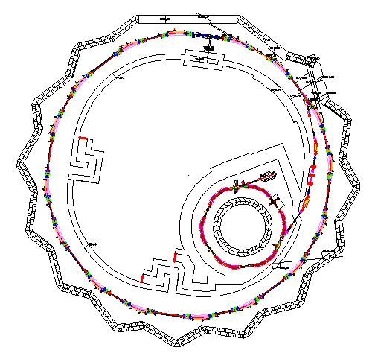
Main Ring Parameters:
Energy = 2.5 GeV
Circumference = 133.2 m
16 Straights sections
{8 x 4.44 m + 8 x 2.38 m}
Up to 28 Beamlines:
Insertion Devices
16 Dipole magnets
Beamlines
length range from
21 m – 36.7 m
800 MeV
Booster
(BESSY 1+ new control, magnet PS and RF amp)
22 MeV
Microtron
(BESSY 1 + new control system)
2.5 GeV
Storage Ring
(Totally new)

Slide 5
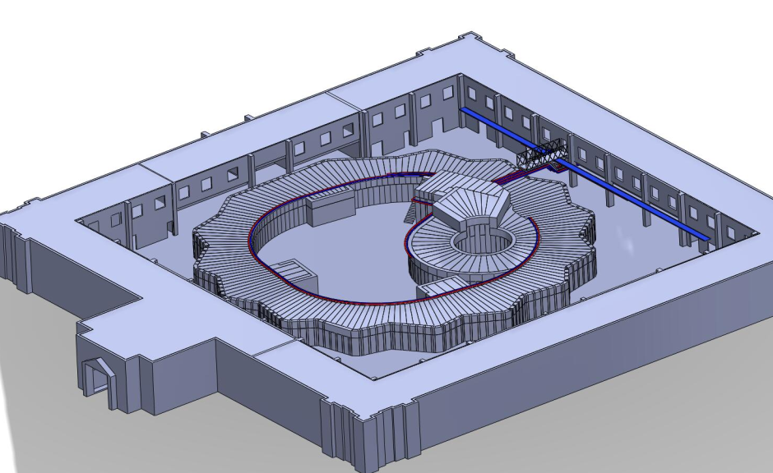
3D View

Slide 6
SESAME milestones:
Microtron commissioning:
Successfully done in July 2009
Booster commissioning:
To be finished in 2011
Storage ring commissioning:
Planned for 2014

Slide 7
Technical staff
 | Name | Field of Activity | Nationality
1 | Maher Attal | Acc. Physics. | Palestine
2 | Firas Makahleh | Cooling system/Vacuum | Jordan
3 | Seadat Varnasseri | Diagnostics &Power Supplies | Iran
4 | Adel Amro | Vacuum/Layout | Jordan
5 | Maher Shehab | Mech. Engineering | Jordan
6 | Arash Kaftoosian | RF | Iran
7 | Darweesh Foudeh | RF | Jordan
8 | Tasaddaq Ali Khan | RF | Pakistan
9 | Moh’d. Alnajdawi | Mechanical Engineering | Jordan
9 | Salman Matalgah | Control System | Jordan
10 | Ahed Aladwan | Control System | Jordan
11 | Adli Hamad | Radiation Safety | Jordan
12 | Thaer Abu Haniah | Alignment & Survey | Jordan
13 | Hamed Tarawneh | Acc. Physics/ Magnet | Jordan
14 | Moayyad Sbahi | Cabling | Jordan
15 | Saed Budair | Vacuum | Jordan

Slide 8
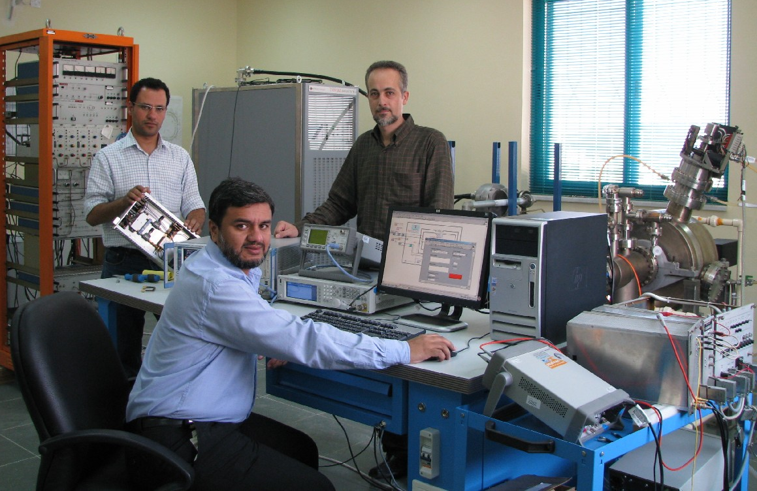
The RF Group
Arash Kaftoosian
(RF, Amplifiers, Cavity, Group leader)
Darweesh Foudeh
(Electronics, LLRF)
Tasaddaq Ali Khan
(Control H/S, LLRF)

Slide 9
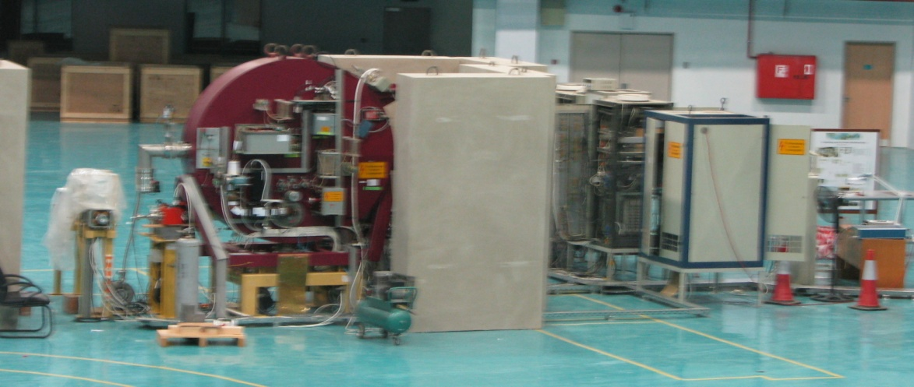
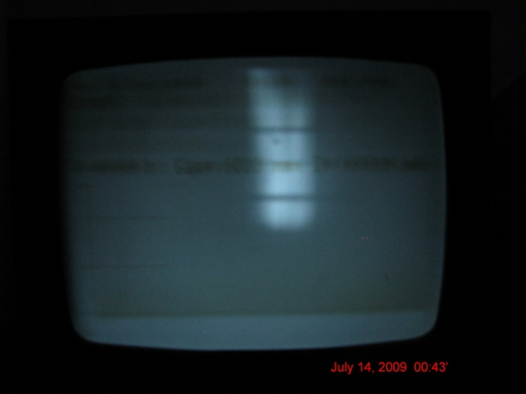
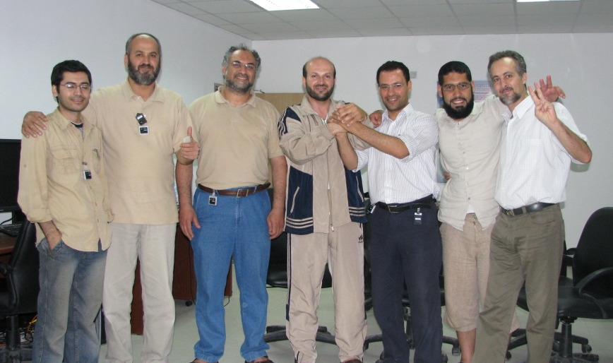
Microtron Commissioning
First beam obtained from Microtron in July 14, 2009
RF group was in charge of:
The 3 GHz, 2MW (peak) RF system
The RF gun and auxiliary gun
The electronics and power supplies

Slide 10
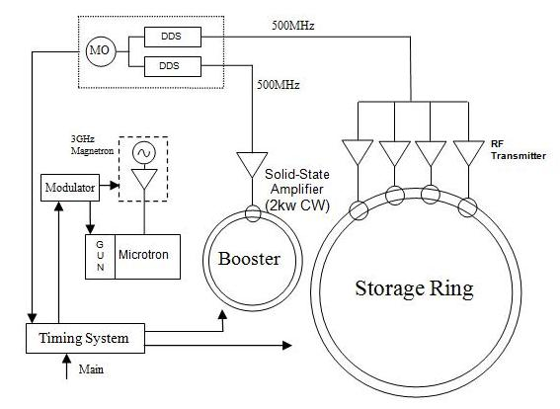
General layout of the SESAME RF system
Parameter | Booster | Storage ring
RF frequency | 499.654 MHz | 499.654 MHz
Harmonic number | 64 | 222
Circumference | 38.4 m | 133.20 m
Revolution freq. | 7.807 MHz | 2.25 MHz
RF wavelength | 0.600 m | 0.600 m
Coincidence freq. | 70.334 KHz

Slide 11
Storage Ring main RF parameters
Parameter | Value
Energy | 2.5 GeV
Circumference | 133.20 m
RF frequency | 499.654 MHz
Radiation loss/turn | 590 KeV
Beam current (maximum) | 400 mA
Beam power loss (bare machine) | 236 kW
Harmonic number | 222
Momentum compaction factor | 0.00833
Total RF voltage (maximum) | 2.4 MV
Over voltage factor | 4
Number of cavities | 4
Energy acceptance | 1.45 %
Synchrotron frequency | 37 KHz
Synchronous phase | 165.5 º

Slide 12
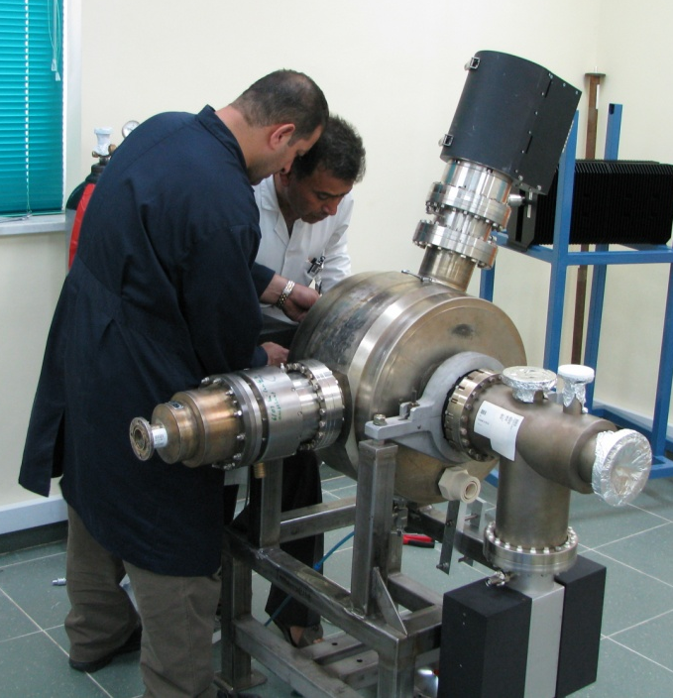
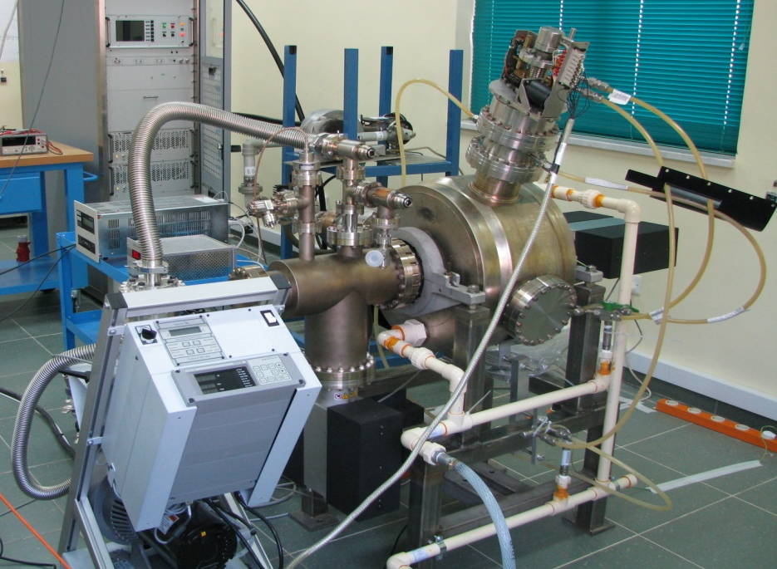
Booster RF system
Booster Cavity and its tuning system shipped from BESSY to the SESAME site in June 2009
(Many thanks to Dr. Ernst Weihreter and Thomas Westphal from BESSY)
Then Cavity prepared for conditioning in the RF lab
(July 2009)

Slide 13
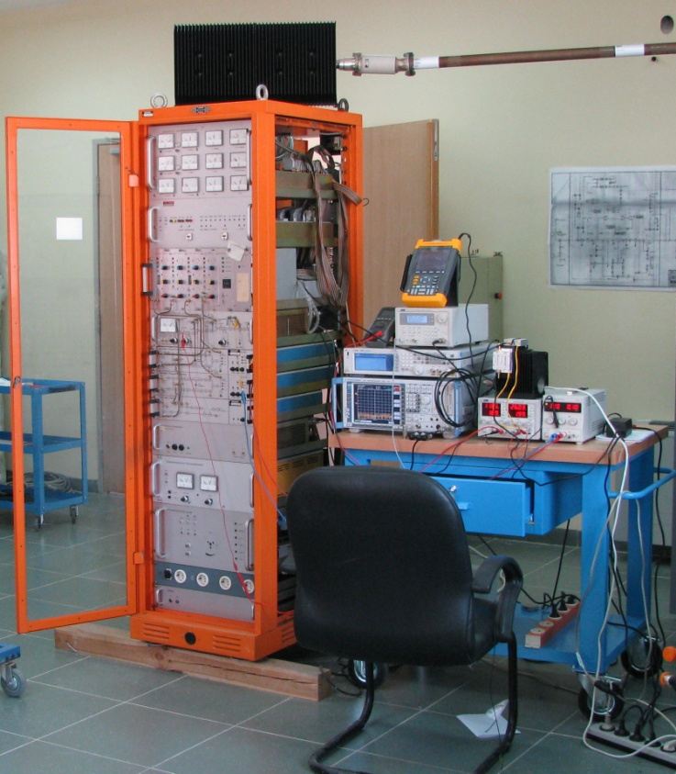
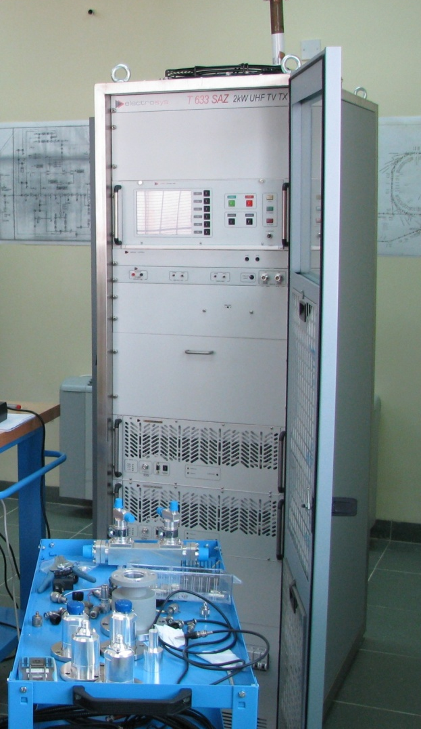
Booster RF system
Booster LLRF (from BESSY I) tested in the RF lab
The new 2kW Solid-State amplifier as replacement for the old klystron used in BESSY I

Slide 14
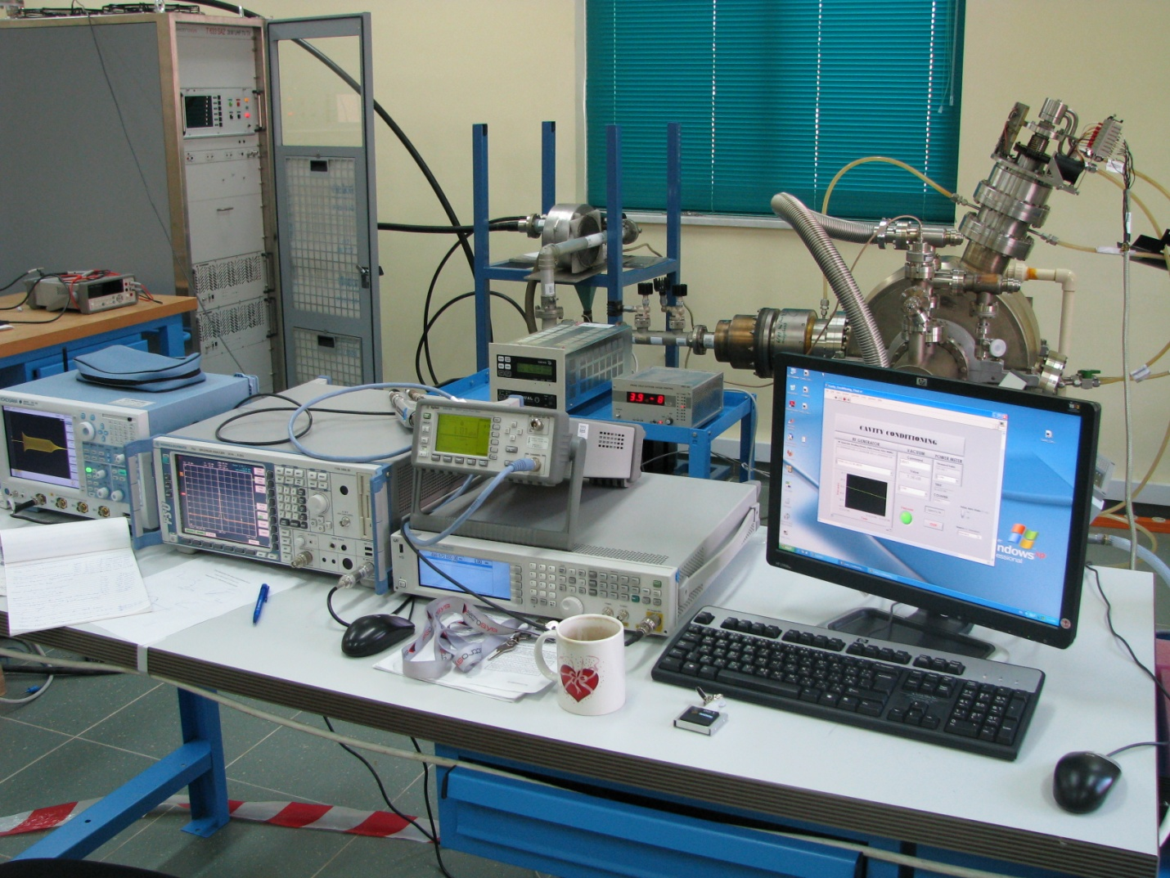
Booster Cavity Conditioning
Booster cavity has been conditioned in the RF lab at SESAME site in July 2009
Cavity conditioned in about 9 hours because it had already conditioned at BESSY with 1 kW RF power

Slide 15
Booster Cavity Conditioning
Cavity conditioning is done with 1.7kW RF power
RF starts from narrow pulse (20us/20ms) increasing pulse width up to CW in 10 steps.
For each pulse width, RF level changes from 500W to 1.7kW in 5 steps
Each step, of totally 50 steps, lasts for 10 minutes
At the starting point, pressure inside the cavity was
If pressure exceeds , RF is turned off for one minute
After finishing the cavity conditioning, plunger was also conditioned for 1 MHz bandwidth around the fundamental frequency, divided into 10 steps, with 5 minutes pause on each frequency.

Slide 16
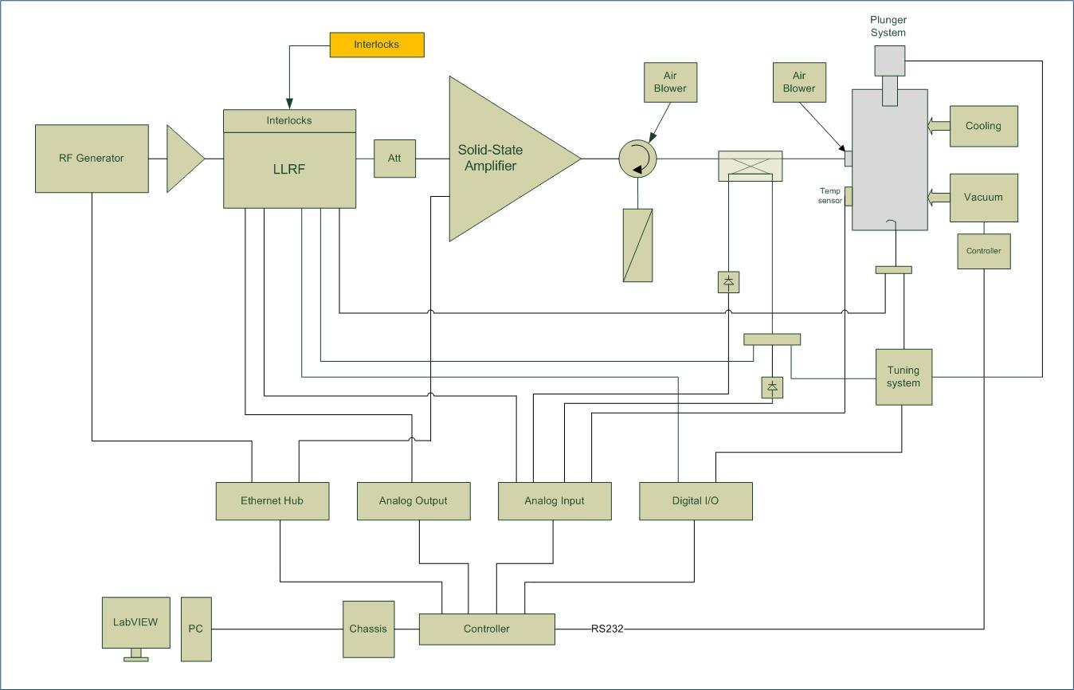
Booster RF system test assembly
From BESSY I
Purchased by
EU fund donation
Donated by Soleil
Local Control Unit (LCU)

Slide 17
Storage Ring RF system

Slide 18
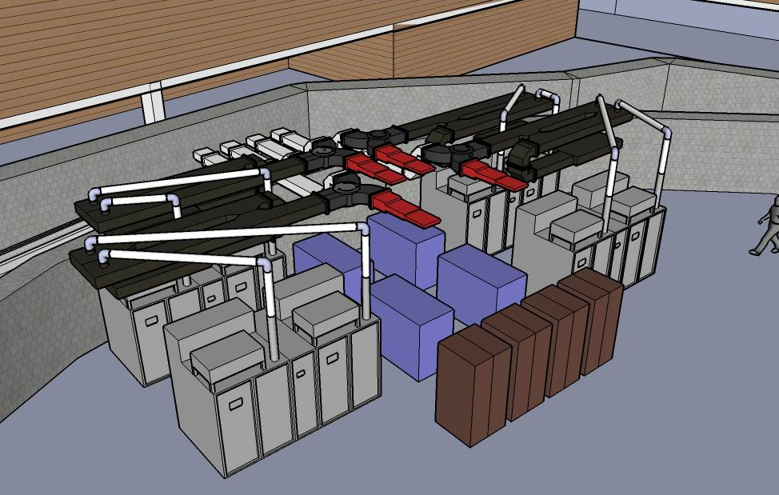
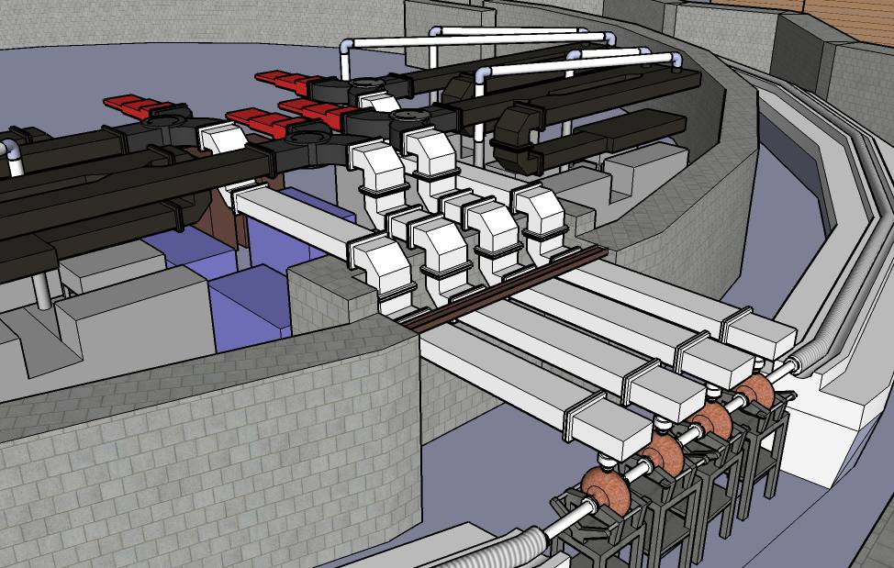
It was initially decided to use 2 x 80 kW IOT for feeding each cavity in the Storage Ring
Now the plan is to develop 140 kW Solid-State amplifiers to be used for each cavity (in collaboration with Soleil)
In phase 1, two ELETTRA cavities (Donation from ELETTRA) will be used in the SR

Slide 19
In the second phase, two more RF plants will be added in order to achieve the maximum current as well as compensation of the power losses due to the Insertion Devices
RF values in phase 1 and 2
Nb of Cav. | Ib mA | VRF MV | Pcav total kW | Over Volt. factor | RF accep % | Pb kW | Ptot needed kW | PRF/cav needed kW | Available Power for IDs kW
2 | 300 | 1.2 | 106 | 2 | 0.75 | 177 | 283 | 141 | 0
4 | 400 | 2.4 | 212 | 4 | 1.45 | 236 | 448 | 112 | 112*
* In case of running the transmitters with 140 kW

Slide 20
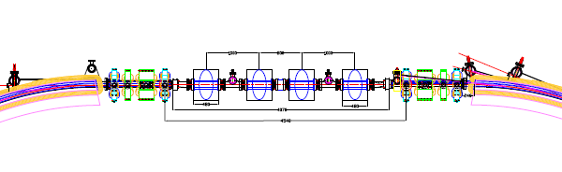
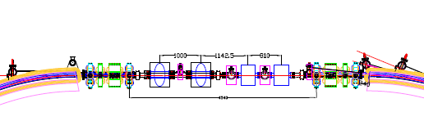
RF cavities in the SR (phase 2)
Fist option: Having 4 ELETTRA cavities
Second option: Having 2 ELETTRA cavities and 2 BESSY cavities

Slide 21
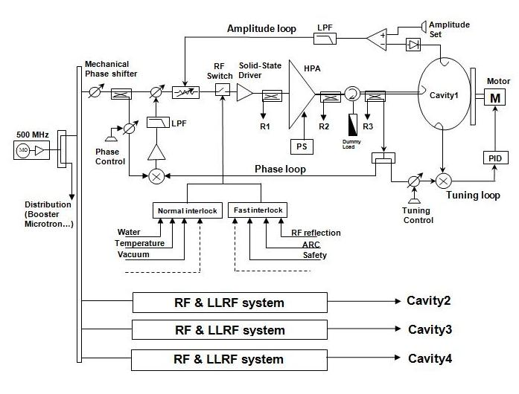
Low Level Electronics (LLRF)
So far, the above analog LLRF has been suggested for the Storage Ring
As a strong alternative, adopting a digital LLRF for the Storage Ring RF system is being studied.

Slide 22
S0lid-State Amplifiers
Two 140 kW 500 MHz solid state transmitters will be developed for feeding two ELETTRA cavities in phase 1
Collaboration with SOLEIL is to be signed
State-of-the-art design for power amplifier modules to have better efficiency and stability
Candidates for transistors: BLF578 (NXP)
(SOLEIL experts suggestion) PRF6VP41 (Freescale)

Slide 23
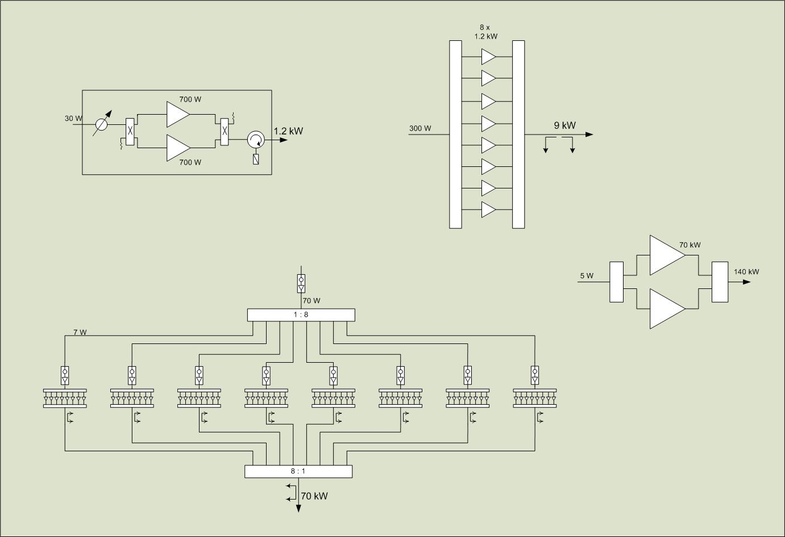
9kW Assembly
HPA Module
Transmitter
One Tower

Slide 24
Advantages of using balanced amplifier (HPA module)
Good isolation between two transistors which improves amplifier stability
Good in-out external match
Better input match → better stability and more efficient power dividing
Cancelation or attenuation of different products and harmonics
Easy to design and integrate since good couplers are available
Using phase shifter to minimize the phase tolerances and increase the power combining efficiency
Easy to change the type of transistor if it is obsolete
Disadvantage: needs two 50 Ω terminations (low and high power)

Slide 25
I would like to thank the European synchrotron light sources for their valuable help and support to SESAME.
My special thanks on behalf of SESAME RF group to BESSY, SOLEIL, ELETTRA and ALBA RF experts who have been always very kind, helpful and supportive to us.
Thank you

